Slide 1
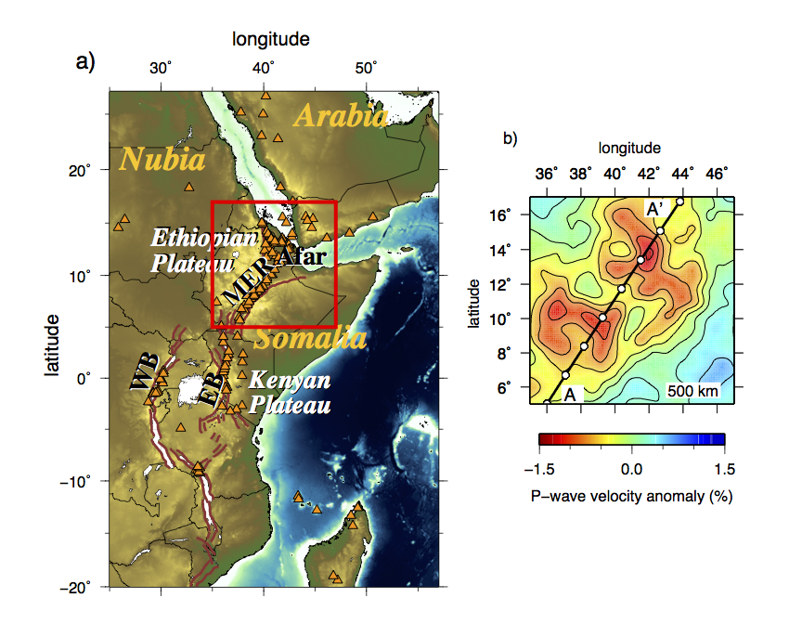
Fig. 1

Slide 2
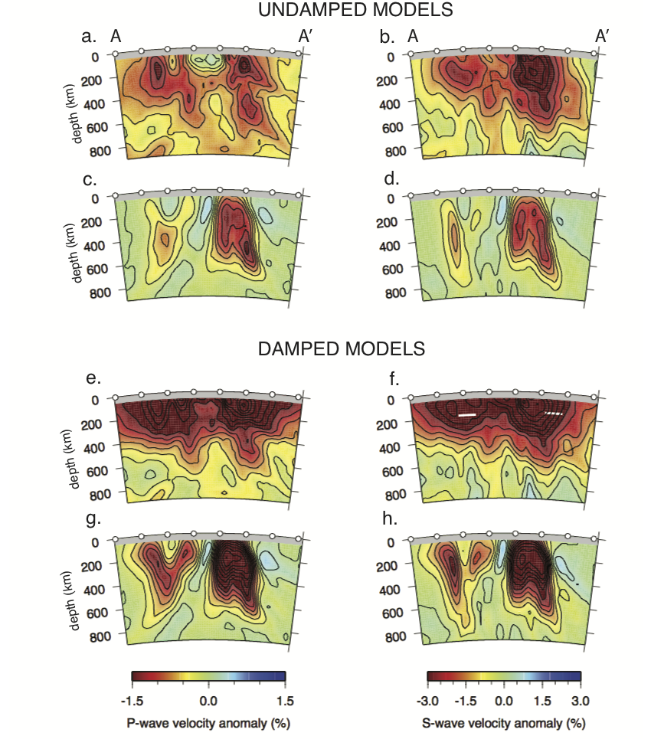
Fig. 2

Slide 3
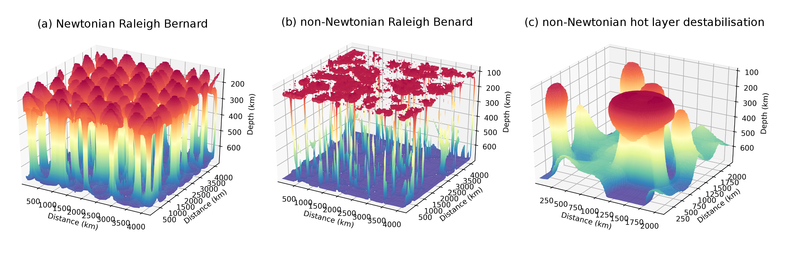
Surface plots of the 1% thermal anomaly (corresponding to a temperature of 1363.5°C if the background temperature is 1350°C) coloured by depth. In all three models the Ra = 6x10⁶. (a) Raleigh Benard convection for a Newtonian rheology showing equally spaced plumes that developed uniformly in time. The model aspect ratio is 6x6x1. (b) Raleigh Benard convection for a non-Newtonian rheology. In this case the strain rate dependence creates thin plumes with flat heads that rapidly impinge on the lithosphere. The model aspect ratio is 6x6x1. (c) Destabilisation of a 100 km thick hot layer in a non-Newtonian fluid. In this case there is a clear difference in the stages of plume formation. The model aspect ratio is 3x3x1.

Slide 4
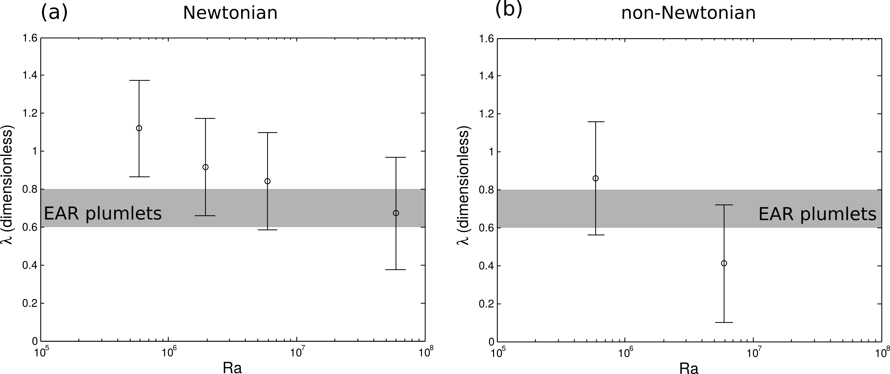
Dimensionless wavelength for Rayleigh Benard convection as a function of Raleigh number. (a) Newtonian models, showing the classic power law dependence between wavelength and Ra. The grey shaded area shows the estimate for the wavelength of the slow Vs anomalies below EAR, made dimensionless by dividing by the depth to the 660 discontinuity. If these instabilities are due to Raleigh Benard convection, we would require a low viscosity (high Ra). (b) Non-Newtonain models, showing a stronger dependence on Ra. However in this case at Ra>10⁷, the plumes become difficult to detect given the plume tails are very thin. If the upper mantle is dominantly non-Newtonian, EAR plumlets are consistent with a higher viscosity (lower Ra)

Slide 5
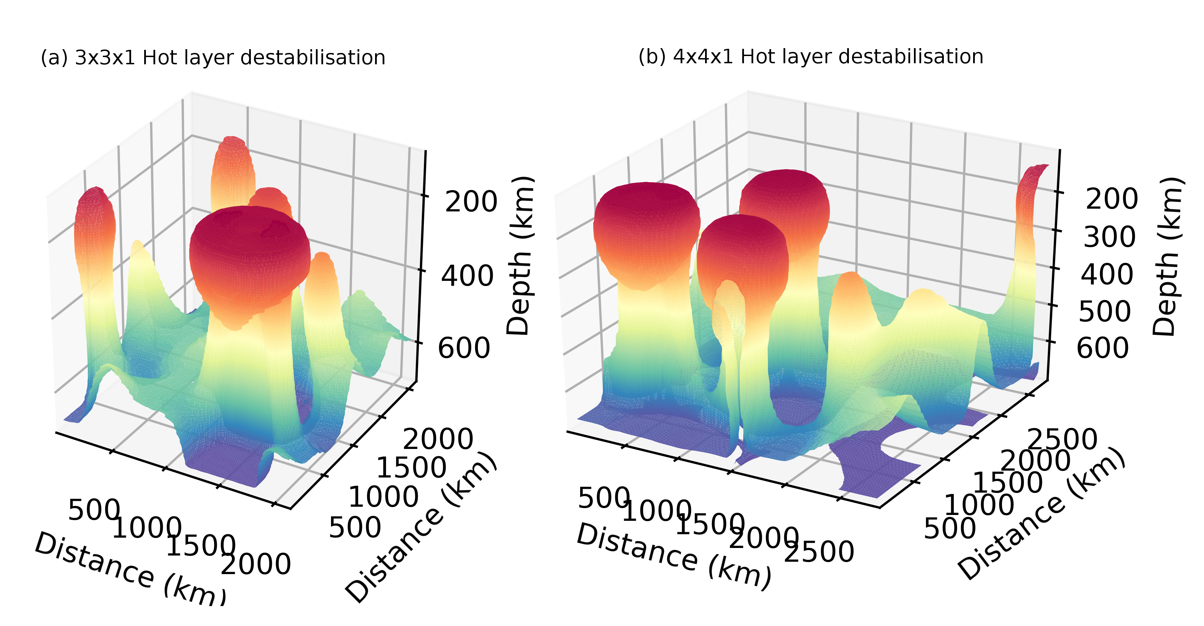
Comparison of patterns of destabilisation of a 100°C hot layer for a 3x3x1 and 4x4x1 Cartesian box.

Slide 6
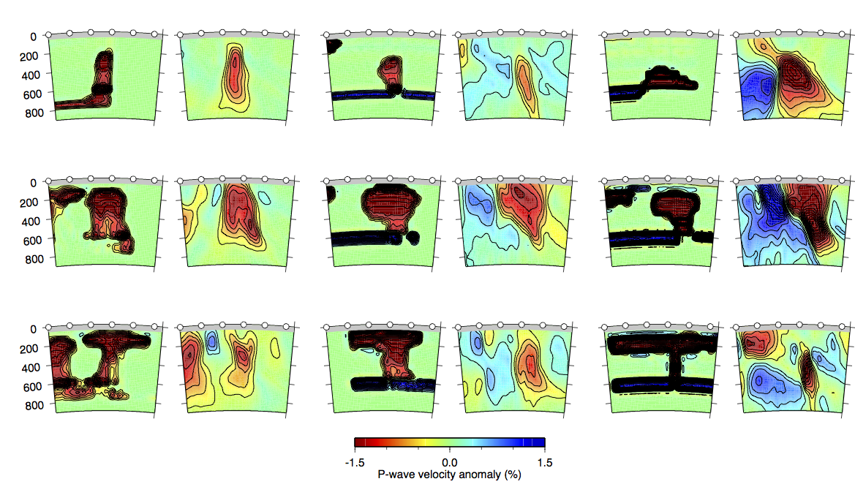
P- undamped
100 K
200 K
400 K
EP
MP
LP
S- waves and damped versions in the Supplementary

Slide 7
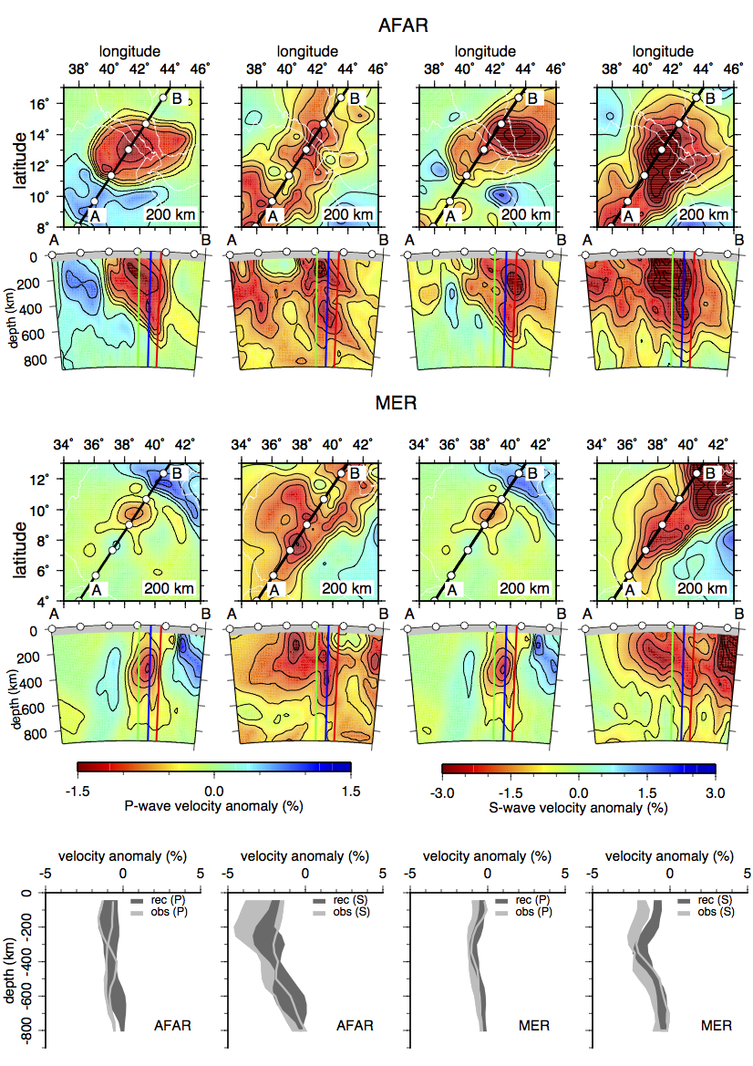
200K model
P-waves & S-waves
Undamped
AFAR > MP
MER > LP
Damped version in the Supplementary

